Slide 1
Zomato data analysis

Slide 2
Introduction
In this presentation, we will explore Zomato's data using Excel to uncover valuable culinary insights. We will analyze trends, customer preferences, and restaurant performance. Get ready to dive deep into the world of food analytics.
This dataset provides comprehensive information on Zomato Restaurants across 15 countries

Slide 3

objective
Cuisine Preferences:
Identify the most popular cuisines based on customer votes and reviews.
City-wise Performance:
Analyze top-performing cities in terms of affordability, customer satisfaction, and service quality.
Service Analysis:
Evaluate the availability of table booking and online delivery services across restaurants to identify areas for improvement.
Trend Analysis:
Assess trends in restaurant openings over time to understand market growth and peak periods.

Slide 4

Steps involved​
Data understanding: Assessing the dataset to understand kind of data, format and identifying common columns incase of multiple tables.
Data cleaning: Utilized Power Query Editor to clean the data by removing null values and special character.
Data modelling: Establish relationships between two tables and add conditional column using power pivot.
Data Visualization: Created an interactive dashboard with 9 KPIs, 3 Slicers and 7 charts using pivot tables.

Slide 5
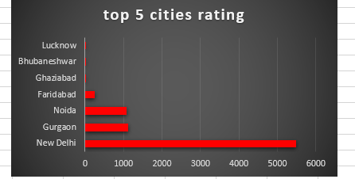
Charts and dashboard
This chart express the ratings of the top 5 cities based on data gathered from Zomato reviews , highlighting the cities with the average ratings. The cities are ranked for their average ratings which reflects the different factor and overall customer feedback.
The highest rated city is New Delhi with 5473 rating from the customers and the lowest rated city is Lucknow with 21 ratings from the customer.

Slide 6
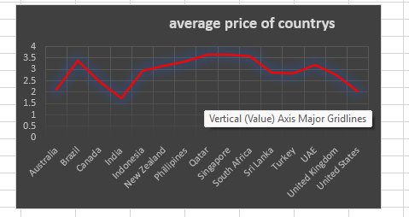

Slide 7
Effective delivery techniques​
Voice modulation is a powerful tool in public speaking. It involves varying pitch, tone, and volume to convey emotion, emphasize points, and maintain interest:
Pitch variation​
Tone inflection​
Volume control
Effective body language enhances your message, making it more impactful and memorable:
Meaningful eye contact
Purposeful gestures
Maintain good posture
Control your expressions

Slide 8
Navigating Q&A sessions
Know your material in advance​
Anticipate common questions​
Rehearse your responses
Maintaining composure during the Q&A session is essential for projecting confidence and authority. Consider the following tips for staying composed:​
Stay calm​
Actively listen​
Pause and reflect​
Maintain eye contact

Slide 9

Speaking impact​
Your ability to communicate effectively will leave a lasting impact on your audience​
Effectively communicating involves not only delivering a message but also resonating with the experiences, values, and emotions of those listening

Slide 10
Dynamic delivery​
Learn to infuse energy into your delivery to leave a lasting impression​
One of the goals of effective communication is to motivate your audience
Metric​ | Measurement​ | Target​ | Actual​
Audience attendance​ | # of attendees​ | 150​ | 120​
Engagement duration​ | Minutes​ | 60​ | 75​
Q&A interaction​ | # of questions​ | 10​ | 15​
Positive feedback​ | Percentage (%)​ | 90​ | 95​

Slide 11
Final tips & takeaways​
Consistent rehearsal​
Practice makes perfect, so strengthen your familiarity with the presentation​
Refine delivery style​
Pacing, tone, and emphasis​
Timing and transitions​
Aim for seamless, professional delivery​
Practice audience
Enlist colleagues to listen & provide feedback​
Seek feedback​
Reflect on performance​
Explore new techniques​
Set personal goals​
Iterate and adapt

Slide 12
Speaking engagement metrics​
Impact factor​ | Measurement​ | Target​ | Achieved​
Audience interaction​ | Percentage (%)​ | 85​ | 88​
Knowledge retention​ | Percentage (%)​ | 75​ | 80​
Post-presentation surveys​ | Average rating​ | 4.2​ | 4.5​
Referral rate​ | Percentage (%)​ | 10​ | 12​

Slide 13
THANK YOU
Brita Tamm​
502-555-0152​
brita@firstupconsultants.com​
www.firstupconsultants.com

